Slide 1

Staying Healthy Assessment (SHA) Training
Information for providers on completing the Staying Healthy Assessment for patients
Developed by Medi-Cal Managed Care Health Plans
Notes:
Welcome to the Staying Healthy Assessment Training. Thank you for taking the time to participate. This training is brought to you by participating Medi-Cal Managed Care Plans in California to assist Medi-Cal providers in implementing the new Staying Healthy Assessment forms. These forms are also referred to as SHA. This training will take approximately 20 minutes to complete.

Slide 2
Agenda
IHEBA/SHA Overview, Goals & Benefits
SHA Completion & Documentation Process
SHA Resources
Electronic SHA & Alternative Assessment Tools
Notes:
Today’s training will include an overview of IHEBA and SHA; goals and benefits; the SHA completion and documentation process, available resources, and use of electronic SHA and alternative IHEBA tools.

Slide 3
Definitions
DHCS:
IHA:
IHEBA:
SHA:
Department of Health Care Services
Initial Health Assessment (DHCS Policy Letter 08-003) includes an IHEBA
Individual Health Education Behavioral Assessment is a generic term for the SHA or DHCS approved alternative assessment tool. IHEBA is a required part of the IHA
Staying Healthy Assessment is the DHCS’s sponsored and approved IHEBA
Notes:
Before we begin, let’s take a brief look at a few definitions. DHCS is the California Department of Health Care Services. DHCS is the regulatory organization overseeing Medi-Cal Managed Care in California. IHA is an Initial Health Assessment required by DHCS Policy Letter 08-003. Completion of a behavioral assessment tool is a required component of an IHA.
The terms IHEBA and SHA are not interchangeable. IHEBA is a generic term for the behavioral assessment required as part of the IHA. An IHEBA is used to identify and document patients’ health education needs related to lifestyle, behavior, environment, culture and language. SHA is the specific assessment tool sponsored and approved by DHCS.

Slide 4
Introduction
  DHCS requires providers to administer an IHEBA to all Medi-Cal Managed Care patients as part of their Initial Health Assessment (IHA) and well care visits.
  The IHA, at a minimum, shall include:
    a physical and mental health history
    identification of high risk behaviors
    assessment of need for preventive screenings or services and health education
    diagnosis and plan for treatment of any diseases
The IHA must be conducted in a culturally and linguistically appropriate manner for all patients, including those with disabilities.
Reference: Title 22, California Code of Regulations, Sections 53851 and 53910.5
Notes:
DHCS requires providers to administer an IHEBA to all Medi-Cal Managed Care patients as part of their Initial Health Assessment and well care visits. The initial health assessment must include a history of the patient’s physical and mental health, identification of high risk factors, assessment of need for preventive screenings or services and health education, diagnosis and plan for treatment of any diseases.
The IHA must be conducted in a culturally and linguistically appropriate manner for all patients, including those with disabilities.

Slide 5
Introduction Continued
New Staying Healthy Assessment (SHA) forms must be implemented by April 1, 2014
Providers are encouraged to begin using the SHA now
Notes:
In June 2013, via policy letter 13-001, DHCS released the new DHCS sponsored IHEBA forms called Staying Healthy Assessment, or SHA. DHCS requires Medi-Cal providers to administer the SHA or other approved assessment forms starting April 1, 2014.
The new SHA was developed based on feedback from providers and allows for more accurate documentation of the educational needs of different age groups. Providers are encouraged to begin using SHA as soon as possible.

Slide 6
Individual Health Education Behavioral Assessment Goals
  Identify and track patient high-risk behaviors
Prioritize patient health education needs related to lifestyle, behavior, environment, and cultural and linguistic needs
Initiate discussion and counseling regarding high-risk behaviors
Provide tailored health education counseling, interventions, referral, and follow-up
Notes:
Let’s now look at the goals of an IHEBA. Since SHA is a specific IHEBA, these are also the goals of the SHA. Goals are to:
Identify and track patient high-risk behaviors
Prioritize patient health education needs related to lifestyle, behavior, environment, culture and language
Initiate discussion and counseling regarding prioritized high-risk behaviors
Provide health education counseling, intervention, referral and follow up

Slide 7
Benefits to Providers and Patients
Builds trust between provider and patient
Improves patient-provider relationship and patient satisfaction
Allows for more personalized care plans
Streamlines HEDIS documentation for providers, ensures members get preventive health services
Allows provider to document patient counseling
Notes:
The benefits of completing an IHEBA or SHA include:
Builds trust between provider and patient.
Improves patient-provider relationship and patient satisfaction
Allows for the development of more personalized care plans
Streamlines HEDIS documentation
Ensures members receive preventive health services and
Provides a way to easily document patient counseling

Slide 8
SHA Periodicity Table
Questionnaire | Administer | Administer/Re-administer |  | Review
Age Groups | Within 120 Days of Enrollment | 1st Scheduled Exam (after entering new age group) | Every 3-5 years | Annually (Interval Years)
0-6 mo.
7-12 mo.
1-2 yrs.
3-4 yrs.
5-8 yrs.
9-11 yrs.
12-17 yrs.
Adult
Senior
Notes:
This table illustrates the periodicity of the SHA. The new updated SHA forms have expanded age categories including 0-6 months, 7-12 months, 1-2 years, 3-4 years, 5-8 years, 9-11 years, 12-17 years, and adults. There is now a new assessment for specifically for seniors. New members must complete the SHA within 120 days of enrollment as part of the IHA. Subsequent SHA administration is required at the next doctor appointment after entering a new age group. Current members who have not completed an updated SHA must complete one during the next preventive care office visit. Annual review of the SHA is required for members age 0-17 years during the years between administering a new SHA. Subsequent SHA administration is required every 3-5 years for adults and seniors.

Slide 9
SHA Recommendations
  12-17 years old age group:
Encourage patients to complete the SHA without a parent/guardian
Annual re-administration is recommended
Adults and Seniors age group:
After 55 years of age, use Adult or Senior SHA that is best suited for patient
Annual re-administration is recommended for seniors
Notes:
Although not required, Policy Letter 13-001 recommends that adolescents (12–17 years) complete the SHA without parental/guardian assistance beginning at 12 years of age, or at the earliest age possible due to teen health confidentiality laws and to increase the likelihood of obtaining accurate responses to sensitive questions. The PCP will determine the most appropriate age, based on discussion with the parent/guardian and the family’s ethnic/cultural background. Annual re-administration of the SHA is highly recommended for this age group due to rapidly changing risk factors.
While there are no designated age ranges for the adult and senior assessments, the adult assessment is intended for use by 18 to 55 year olds. The age at which the PCP should begin administering the senior assessment is based on the patient’s health status, mobility and chronic chronic conditions and not exclusively on the patient’s biological age. Annual re-administration of the SHA is also highly recommended for seniors.

Slide 10
SHA Completion
  Assisting the patient in SHA completion:
Explain the SHA’s purpose and how it will be used
Assure that SHA responses are confidential and will be kept in patient’s medical record
Encourage the patient to self-complete the SHA
Optional:
SHA questions may be asked verbally and responses recorded directly in patient’s electronic medical record
Notes:
When asking patients to complete the SHA, provider offices should explain the purpose of the SHA and how the information will be used. Assure the patient that the information is confidential and kept in the patient’s medical record. Encourage the patient to self-complete the SHA if age appropriate. Let the patient know that the SHA is available in multiple languages and that interpreting services along with accommodations for any disability are available.
If preferred, providers can ask SHA questions verbally and record patient responses directly into patient’s electronic medical record.

Slide 11
SHA Refusal
Patients have the right to refuse, decline or skip any or all parts of the SHA
Encourage patient to complete an age appropriate SHA every subsequent year during a scheduled exam
Notes:
Patients may refuse, decline, or skip any or all parts of the SHA. However, patient refusals must still be documented and kept in the patient’s medical record. Patients who refuse to complete the SHA should still be encouraged to complete a new SHA every subsequent year.

Slide 12
SHA Provider Review
  Reviewing the completed SHA with the patient:
Determine extent of risk factors on patient’s health
Prioritize risk factors to discuss
Provide tailored health education counseling, intervention, referral, follow up, and risk reduction plan
Notes:
PCPs are required to review the SHA with the patient. Other clinic staff may assist with this review as long as medical issues are referred to the PCP.
During the review, the PCP is required to verify risk factors and determine the extent to which these risk-factors may be harming the patient’s health. These risk factors should then be prioritized and discussed as time allows. Whenever possible, the PCP and the patient should develop a mutually agreed-upon risk reduction plan. Based on the patient’s behavioral risks and willingness to make lifestyle changes, the PCP should provide tailored health education counseling, intervention, referral, and follow-up.

Slide 13
SHA Provider Review
  Alcohol use question:
The alcohol screening question is based on USPSTF recommendations
#19 on the Adult SHA
#23 on the Senior SHA
Notes:
The adult and senior SHA have a new alcohol screening question based on US Preventive Services Task Force recommendations, number 19 and 23 respectfully.
This new question assesses whether over the past year, the patient has had the following number of alcoholic drinks in one day:
4 or more for women and seniors
5 or more for men

Slide 14
SHA Provider Review
  New Screening, Brief Intervention and Referral for Treatment (SBIRT) benefit:
If “yes” to alcohol question, offer an expanded screening questionnaire (such as the AUDIT or AUDIT-C) and if indicated, one to three 15-minute brief interventions
These screening questionnaires identify patients with potential alcohol use disorders who need referral for further evaluation and treatment
Notes:
AUDIT is a 10-item questionnaire that assesses whether alcohol use is impairing the member’s functioning.
AUDIT-C is a 3-item questionnaire that assesses the member’s consumption level.
Information for presenter to answer potential follow-up questions:
If indicated means the following: When the score is high, the patient should be referred to treatment. When the score is medium, the patient may not need to be referred to treatment and, instead, should be offered brief interventions. This will be further explained during the special training that is required before any provider can offer SBIRT.
NOTE to PRESENTERS:
MCPs are receiving additional capitation in order to provide these screening and brief intervention services. MCPs are responsible for how they pass along any additional capitation to their providers.

Slide 15
SHA Provider Review
  Screening, Brief Intervention and Referral for Treatment (SBIRT):
Providers offering SBIRT are required to take special training. A list of training resources is available – contact your health plan for more information
The alcohol SBIRT benefit went into effect January 1, 2014
Notes:
Providers must attest to having completed special training before they can offer Screening, Brief Intervention and Referral for Treatment services and cannot offer these services prior to being trained. If a patient answers yes on the SHA alcohol screening question untrained providers must either refer the patient for SBIRT screening by a trained provider or schedule the patient for follow-up after the provider has been trained. Training will be available online from a variety of free or low cost educational websites. DHCS may also provide training for Medi-Cal Managed Care Health Plans. Contact your Medi-Cal Managed Care Health Plan for more information. The new alcohol screening benefit went into effect January 1, 2014.

Slide 16
SHA Documentation
The provider must:
Sign, print his/her name, and date
Document specific behavioral-risk topics and patient counseling, referral, anticipatory guidance, and follow-up provided
Keep signed SHA in patient’s medical record
Document SHA reviews and SHA refusals
Notes:
Documentation on the new SHA is easy. For an initial SHA, the PCP signs, prints his or her name, and dates the questionnaire on the second page. The PCP also documents the specific behavioral-risk topics discussed and checks the types of interventions offered to the patient such as counseling, referral, anticipatory guidance or follow-up.
During the intervening years between re-administration of the SHA, the PCP signs, prints his or her name, and dates the “SHA Annual Review” section of the questionnaire.
A signed SHA must be kept in the patient’s medical record, even if the patient declines to complete the SHA.

Slide 17
SHA Refusal Documentation
Document refusal on the SHA and keep in the patient's medical record
Check box “Patient Declined the SHA”
Provider must sign, print name, and date the back page of form
Notes:
Patient refusal to complete the SHA is documented by checking the box “Patient Declined the SHA” on the second page and including the PCP’s signature, printed name, and date on the back page.

Slide 18
Document HEDIS Measures
The SHA is an additional document to provide evidence of certain Healthcare Effectiveness Data and Information Set (HEDIS) measures that require patient counseling, referral, the provision of anticipatory guidance, and follow-up, as appropriate.
    Age 0-15 months
  Well child visits ages 0-15 months – Health Education/Anticipatory Guidance
    Age 3-17 years
  Weight assessment and counseling for nutrition and physical activity
    Age 12-21 years
  Adolescent well care – Health Education/Anticipatory Guidance
  Chlamydia screening
  HPV vaccination
  Prenatal care if pregnant (applies at any age)
  Postpartum care (if appropriate)
Notes:
Another benefit of the SHA is that it can be used as an additional document to show evidence of certain HEDIS measures that require patient counseling, referral, provision of anticipatory guidance, and follow-up. This ultimately helps streamline the HEDIS auditing process. For example, appropriate documentation for the pediatric obesity HEDIS measure can be documented by checking the “Nutrition” and “Physical Activity” topics in the “Clinic Use Only” section of the SHA questionnaire as well as by checking the “Counseling, Referral, Anticipatory Guidance, and Follow-up Ordered” boxes. PCP’s signature, printed name, and date of service must also be documented. Other HEDIS measures for which the SHA can be used as documentation include the anticipatory guidance component of well-child and well-adolescent visits, chlamydia screening, HPV vaccination and prenatal/postpartum care as appropriate.

Slide 19
Document HEDIS Measures
    Adults
  Chlamydia screening
  Prenatal care if pregnant
        Notify Health Plan of all pregnancies by using the pregnancy notification form (as appropriate)
        Postpartum care (if appropriate)
    Seniors
  Care for older adults
  Functional status screening
  Advance directive
Notes:
Other adult and senior HEDIS measures for which a completed SHA can be used as evidence include chlamydia screening, prenatal care, care for older adults, functional status screening and advance directive. Please remember to notify the Health Plan of all pregnancies by completing a pregnancy notification form.

Slide 20
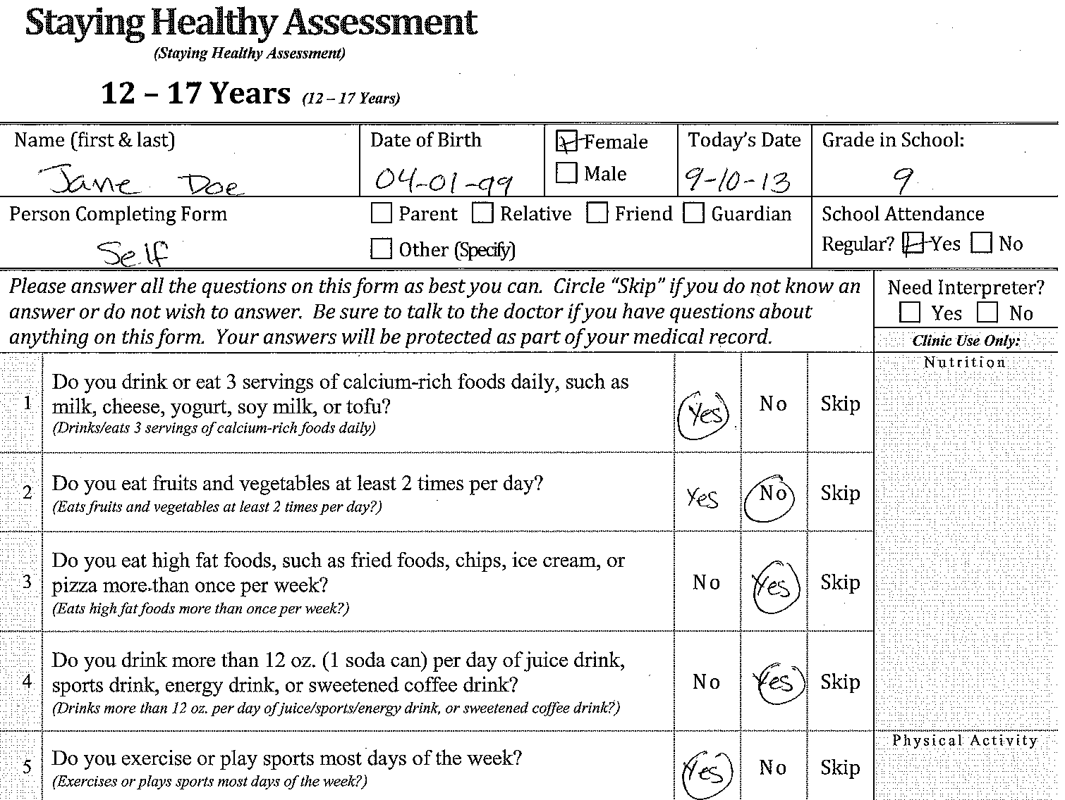
1
2
Notes:
Let’s now take a look at how to appropriately complete and document the SHA. Arrow 1 indicates where the patient begins to fill out the form. Arrow 2 indicates the “Shaded “Clinic Use Only” section on the first page. This section, along with the “Comments” section on the second page, are used to take notes regarding patient discussion and recommendations.

Slide 21
2
1
2
Notes:
Sample questions, also showing that questions can be skipped.
At the end of the last question, patients can write down any other health concerns or questions they may have. Make sure to address these questions or concerns.
Answers circled in the *middle column (where the 2nd arrow is pointed, highlighted column) indicate a risk factor. If a risk factor is identified, the provider should explore this topic with the patient and determine the extent to which it may be harming the patient’s health.
* “Yes” and “No” are not always in the same columns. (Important to point out to patient completing it)

Slide 22
1
3
4
2
Notes:
Arrow 1 on this slide is the “clinic use only” section on the second page. This section documents which topics were discussed and what type of assistance was provided to the patient. Assistance options include tailored health education counseling, referral, anticipatory guidance materials, and follow-up. For each health topic addressed with the patient one or more of these boxes must be checked based on SHA responses.
Arrow 2 is where the PCP must sign, print his/her name and date a newly administered SHA.
Arrow 3 is the “Comments” section which may be used to take notes about patient discussion and recommendations. This section can also be used to note changes to patient responses or to provide recommendations during annual reviews.
Arrow 4 is the Patient Declined the SHA box which is used when a patient refuses to complete the SHA. To fully document a patient’s refusal, enter the patient’s name and date on first page, check the box “Patient Declined SHA” on the back page, and have the PCP sign, print his/her name and date the back page.

Slide 23
1
3
2
Notes:
This slide highlights the documentation required for HEDIS and annual review.
Arrow 1 is the“clinic use only” section. This section indicates what topics were discussed and what type of assistance was provided to the patient. To be acceptable for HEDIS documentation, this section must be completed.
Arrow 2 is where the PCP documents subsequent SHA review with the patient. Refer to the periodicity chart to determine how often reviews should happen for each age group. PCP must sign, print name and date “SHA Annual Review” section. The SHA must include this documentation to be permissible for HEDIS.
Arrow 3 is the “Clinic Use Only” section on the first and second pages of the SHA as well as the “Comments” section on the second page. These sections may be used to note changes to patient responses or to provider recommendations during subsequent SHA reviews.

Slide 24
SHA Resources
All SHA forms are available for download and printing on the DHCS site at:
www.dhcs.ca.gov/formsandpubs/forms/Pages/StayingHealthy.aspx
Available languages:
Arabic* | Khmer*
Armenian | Korean
Chinese | Russian
English | Spanish
Farsi* | Tagalog
Hmong | Vietnamese
* These languages are not currently available on the DHCS website, but can be obtained by contacting your health plan.
Notes:
Most SHA forms are available for download and printing on the DHCS website at www.dhcs.ca.gov/formsandpubs/forms/Pages/StayingHealthy.aspx. The SHA is available in 7 age categories and 12 languages including Arabic, Armenian, Chinese, English, Farsi, Hmong, Khmer, Korean, Russian, Spanish, Tagalog, and Vietnamese. Arabic, Farsi, and Khmer are not accessible on the DHCS website. These languages are available through your contracted Medi-Cal Managed Care health plan.

Slide 25
SHA Electronic Format
Notify health plan at least two months before start
Electronic formats: add SHA questions into an electronic medical record, scan the SHA questionnaire into EMR, or use the SHA in another alternative electronic or paper-based format
Electronic provider signature needed
Must include all updated and unaltered SHA questions
Your health plan will review the electronic format to ensure it meets all requirements prior to implementation
Notes:
The SHA may be used in an electronic format under certain conditions. Providers must notify their Medi-Cal Managed Care health plan(s) at least two months prior to implementation. Electronic formats include manually adding SHA questions into an EMR, scanning SHA and then placing it in an EMR, or using SHA in another electronic or paper-based format. Any electronic SHA must include a provider signature. The SHA questions must be the most updated version and may not be altered from the original version. Your health plan will review the electronic format to ensure it meets all requirements prior to implementation..

Slide 26
Alternative Assessment Tool
Use of the SHA tool is strongly recommended
  Alternatives are permitted but require pre-approval by DHCS
    Submit request for approval to use alternative assessment tool through your health plan
Any alternative assessments must be translated to the threshold languages of the health plan’s members and meet all the same standards as the SHA
The American Academy of Pediatrics Bright Futures assessment has been pre-approved by DHCS as an alternative IHEBA. It can be used as long as certain conditions are met. Contact your health plan for more information
Notes:
DHCS and Medi-Cal Managed Care Plans strongly encourage providers to use the SHA. However, an alternative behavioral assessment tool may be used but requires pre-approval by DHCS. An alternative assessment tool is any other tool that is not SHA.
A request to use an alternative assessment must be submitted to your Medi-Cal Managed Care health plan two months prior to implementation along with a copy of the proposed alternative assessment. The request must also include evidence that the alternative assessment contains similar content, risk factors, and administration periodicity as the SHA. The request must also be accompanied by copies of alternative assessment tools translated into the appropriate threshold languages for each contracted county.
Your health plan will submit this request to DHCS. Requests for previously approved alternative assessments must be re-submitted every 3 years.
Providers may use the American Academy of Pediatrics Bright Futures assessment without DHCS approval, as long as certain conditions are met. Contact your health plan for more information.

Slide 27
SHA Additional Resources
SHA Provider Office Instruction Sheet
SHA Behavioral Risk Topics
SHA Pediatric Questions by Age Groups
SHA Adult Questions by Age Groups
All SHA additional resources are available through the DHCS website.
www.dhcs.ca.gov/formsandpubs/forms/Pages/StayingHealthy.aspx
Notes:
Additional SHA resources are provided on the DHCS website and include: A SHA provider office instruction sheet; a list of all behavioral risk questions by health category, and pediatric and adult questions referenced by age category.
The DHCS website also includes information regarding SHA provider training opportunities.

Slide 28
Heath Plan’s Resources
Contact your health plan on available health education programs, cultural and linguistic services, and resources.
Notes:
All Medi-Cal Managed Care Health Plans have plan-specific SHA, health education and cultural and linguistic resources available. Contact your health plan directly for more information.

Slide 29
Thank You!
Notes:
Thank you for participating in the Staying Healthy Assessment Training. On behalf of your contracted Medi-Cal Managed Care Health Plans, we hope you found this training beneficial. If you have any questions or need assistance implementing the SHA forms, please contact your contracted health plan.

